Slide 1
MnDOT Research Program Update

Slide 2
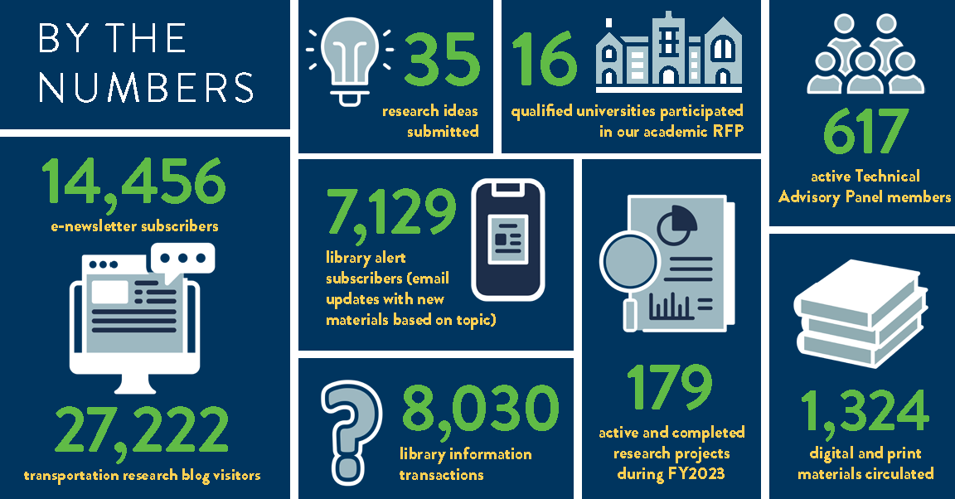
Notes:
We worked on 179 research projects with 16 universities across the country, guided by 617 technical advisory panel members
Over 14,000 folks were subscribed to our e-newsletter and over 27,000 individuals accessed our transportation research bog.
Our fantastic librarians completed over 8,000 information transactions and circulated over 1,000 print and digital materials.

Slide 3
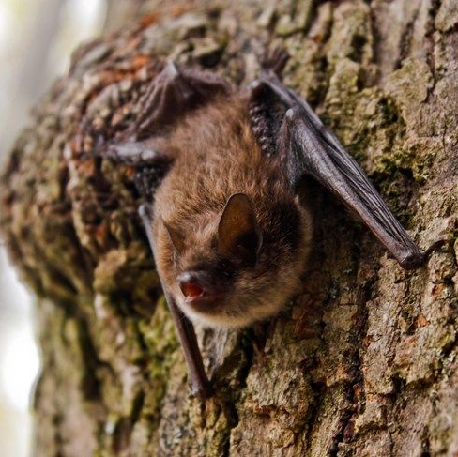
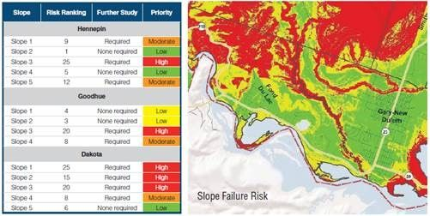
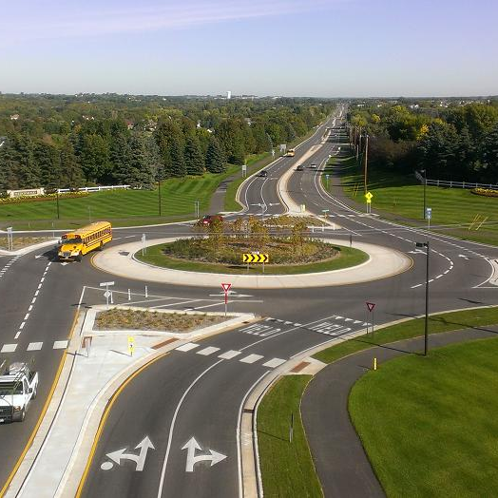
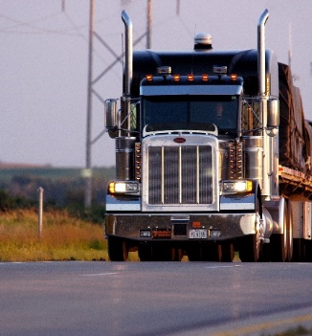
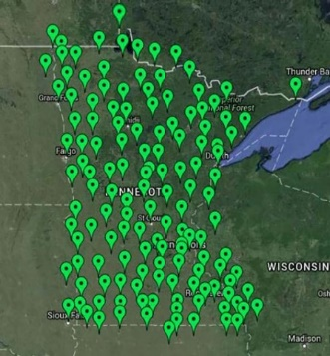
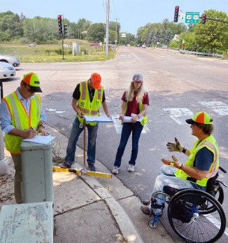
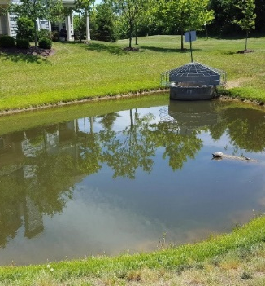
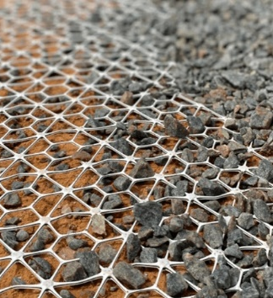
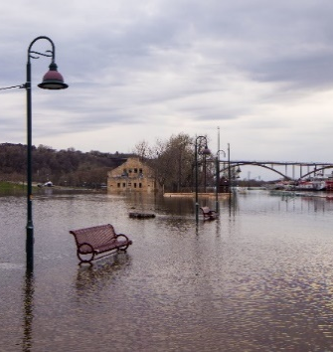
Research in Progress
Species From Feces: A New Tool to Identify Bats in Culverts and on Bridges
Speed Impacts from Roundabouts and Other Traffic Control Devices*
Vulnerability Assessments of Critical Slope Areas Using Advanced Monitoring Techniques
Analyzing Truck Size and Weight Impacts on Vehicle Miles Traveled*
Use of MNCORS to Support AV Operations in Rural Minnesota*
Comparative Analysis of Grade-Separated Pedestrian Infrastructure and At-Grade Treatments*
Quantify the Benefits of Using Geotextiles and Geogrids to Improve the Performance of Unbound Pavement Layers
Assessing Effectiveness of Pond Sediment Removal for Phosphorus Management in Stormwater Ponds*
Investigating Real Storms and the Impact of Potential Climate Change Adaptations
Notes:
Here are some examples of current research projects in Minnesota. A full listing of our research program is included in our At-A-Glance publication.

Slide 4
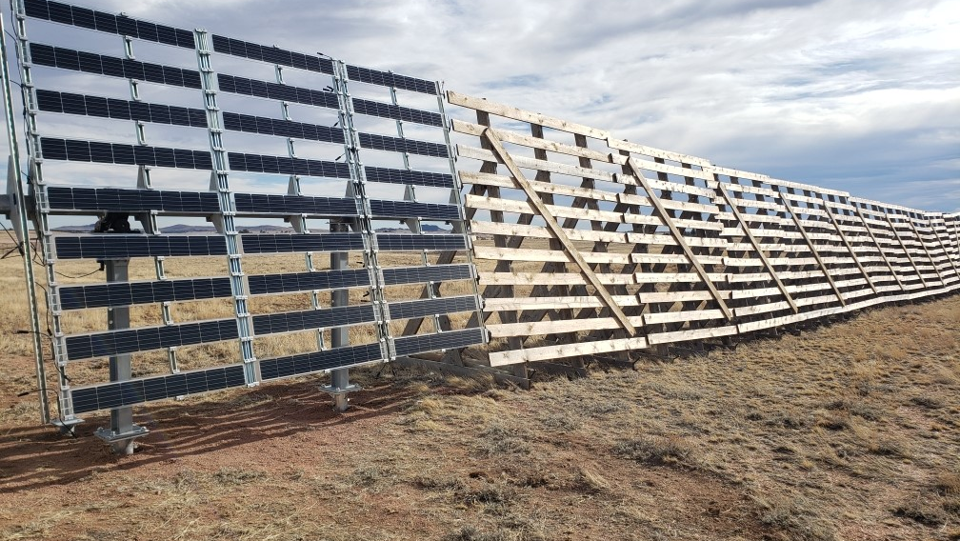
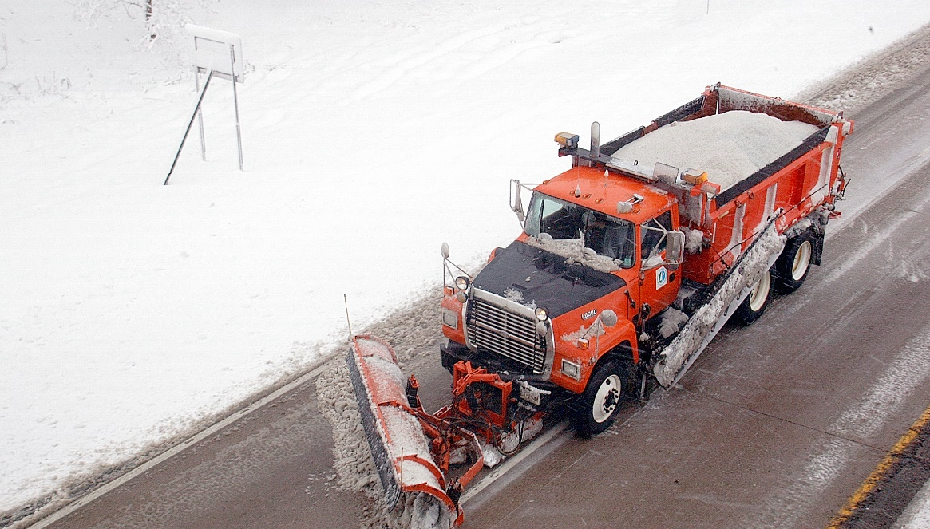
Featured Research Projects
A Lane Boundary Guidance System for Snowplow Operations
Harnessing Solar Energy through Snow Fences

Slide 5
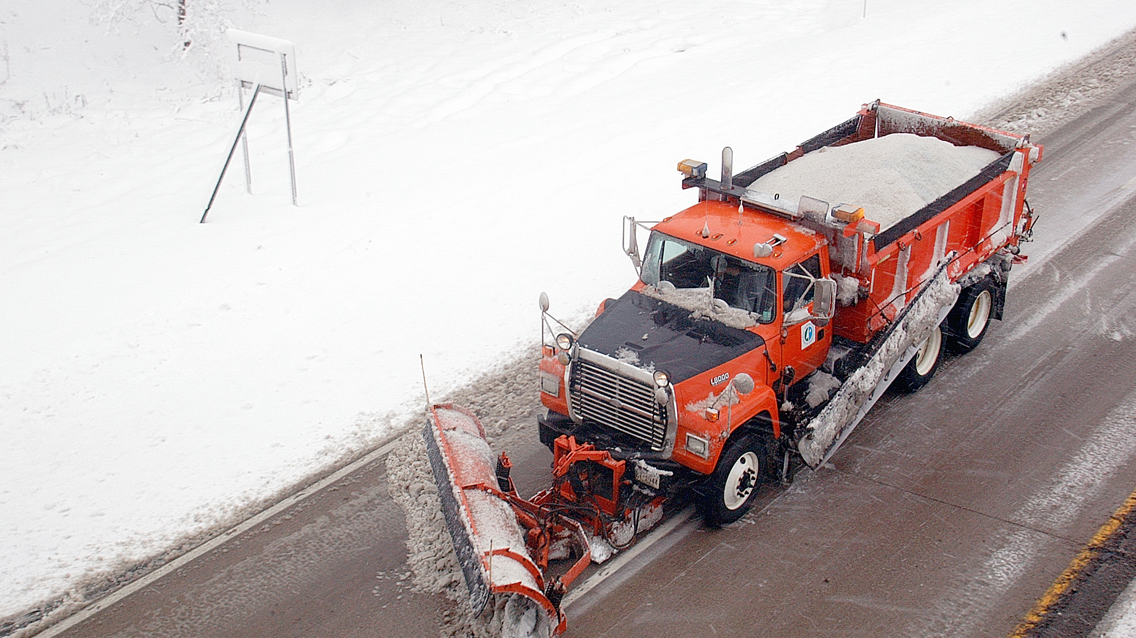
A Lane Boundary Guidance System for Snowplow Operations
Notes:
Completed Project: https://researchprojects.dot.state.mn.us/projectpages/details?id=22003&type=CONTRACT
Active Implementation: https://researchprojects.dot.state.mn.us/projectpages/details?id=28528&type=CONTRACT

Slide 6
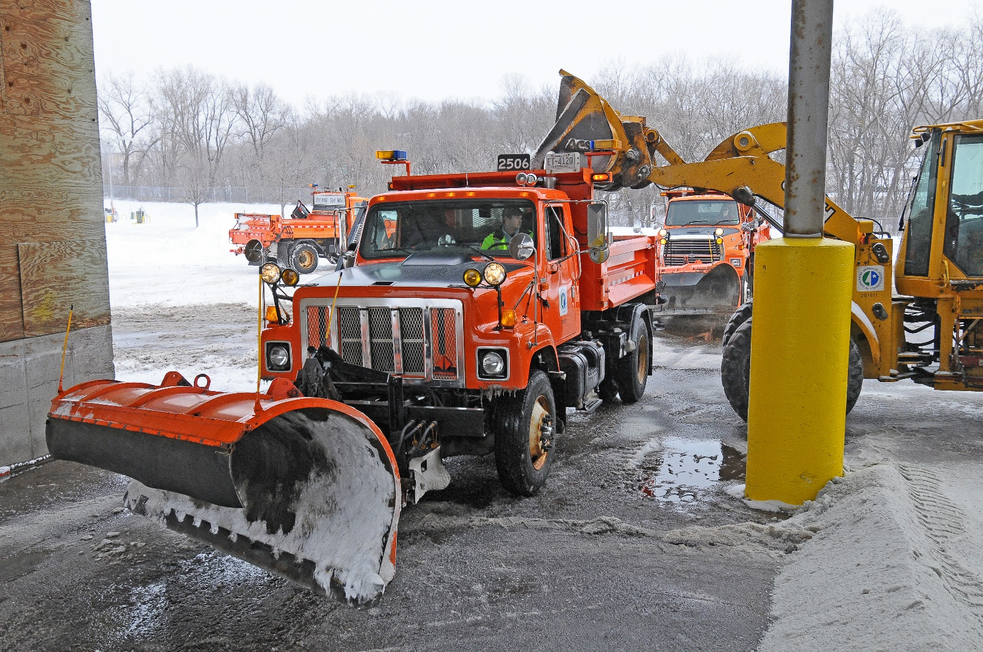
What was our goal?
Support snowplow operators working in no-visibility and low-visibility conditions
Reduce lane departure events and forward obstacle collisions
Increase driver safety
Improved emergency response
Expand operational hours during snow events
Notes:
Support snowplow operators working in no-visibility low-visibility conditions
Reduce lane departure events and forward obstacle collisions
Increase driver safety
Improved emergency response
Expand operational hours during snow events
Additionally, we wanted to create a cost-effective system design that we could add to our trucks moving forward. Our current design costs about $13,000 per truck for hardware.

Slide 7
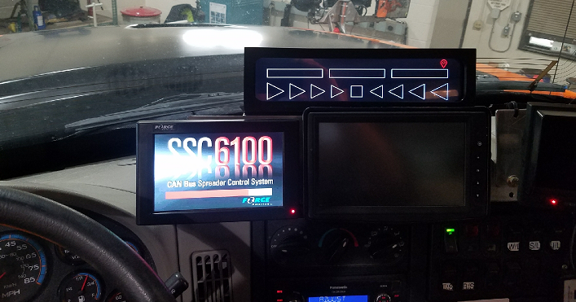

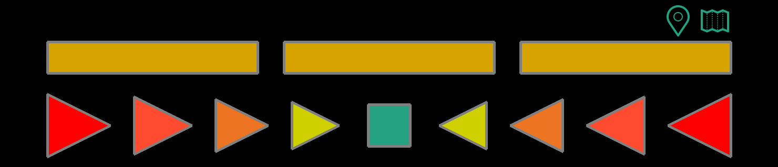
What did we do?
Driver display: LCD screen mounted on dashboard with speaker behind driver
Lane guidance: Precision GPS identifies lateral deviation from centerline in 1-foot increments
Forward obstacle detection: Identifies presence of obstacle ahead of plow with time-to-collision under 5 seconds, indicates location of hazard (left, right, front)
Notes:
LCD screen mounted on dashboard with speaker behind driver
Lane guidance
Lateral deviation from lane centerline in 1-foot increments (precision GPS req.)
Forward obstacle detection
Presence of obstacle ahead of plow with time-to-collision under 5 seconds
Indicates location of hazard – left, right, or directly in front of vehicle

Slide 8

What did we learn?
Research and tested for 20+ years in different forms
Drivers were overall “very satisfied” with the system
But the system needed “hardening” for automotive usage, need 100% reliability
9 snowplows, 300 route-miles
Notes:
9 snowplows with system
All 8 MnDOT districts and Dakota Co.
300 route-miles
Research and tested for 20+ years in different forms
Varied the driver display approach and techniques
Experimented with detection of obstacles and vehicles
Drivers were overall “very satisfied” with the system
“It keeps them on the road”
Display is simple and quick to use
But the system needed “hardening” for automotive usage
“Technology is great when it works”
Need for 100% reliability not 90%

Slide 9
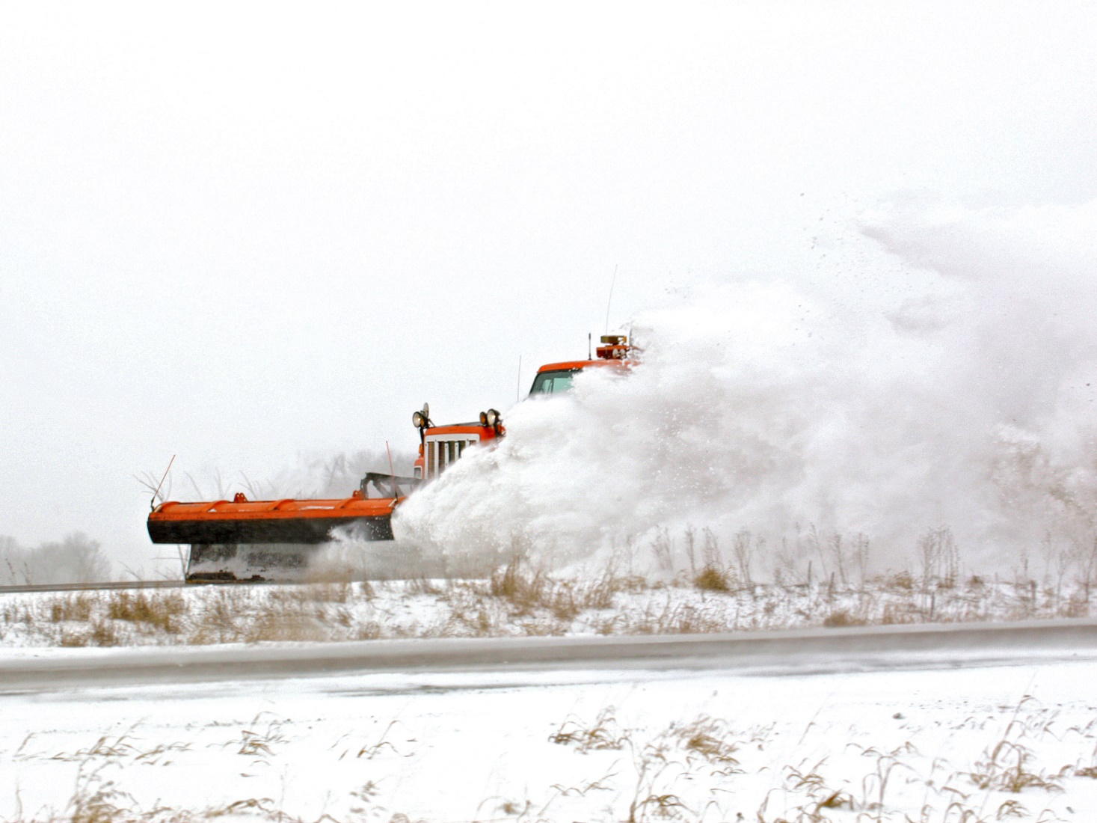


What’s next?
Complete implementation project and system “hardening”
Improve mapping capability, develop statewide map of “center of lane”
Procure new systems, develop MN statewide procurement specification
Subscribe to receive email alerts about this project!
Notes:
Complete implementation project
Complete system “Hardening”
Improved reliability and availability
Improved component design (Dash displays - heat, wiring connections - vibration)
Design life and maintenance of system (modems, and trouble shooting guides)
Improved obstacle detection
Radar returns are very noisy and hard to calibrate in snow events (cycle back to research?)
Continue system operation until Dec 2025
Improve mapping capability
Develop a solution for providing a statewide map of “Center of Lane”
Continue Roadway Features project – identified 21 data sources so far
Procure new systems
Currently developing a MN statewide procurement specification
Scheduled to advertise for new systems May/June 2025 – multi award

Slide 10
Harnessing Solar Energy through Snow Fences
Notes:
Phase 1: https://researchprojects.dot.state.mn.us/projectpages/details?id=22019&type=CONTRACT
Active Implementation: https://researchprojects.dot.state.mn.us/projectpages/details?id=27744&type=CONTRACT

Slide 11
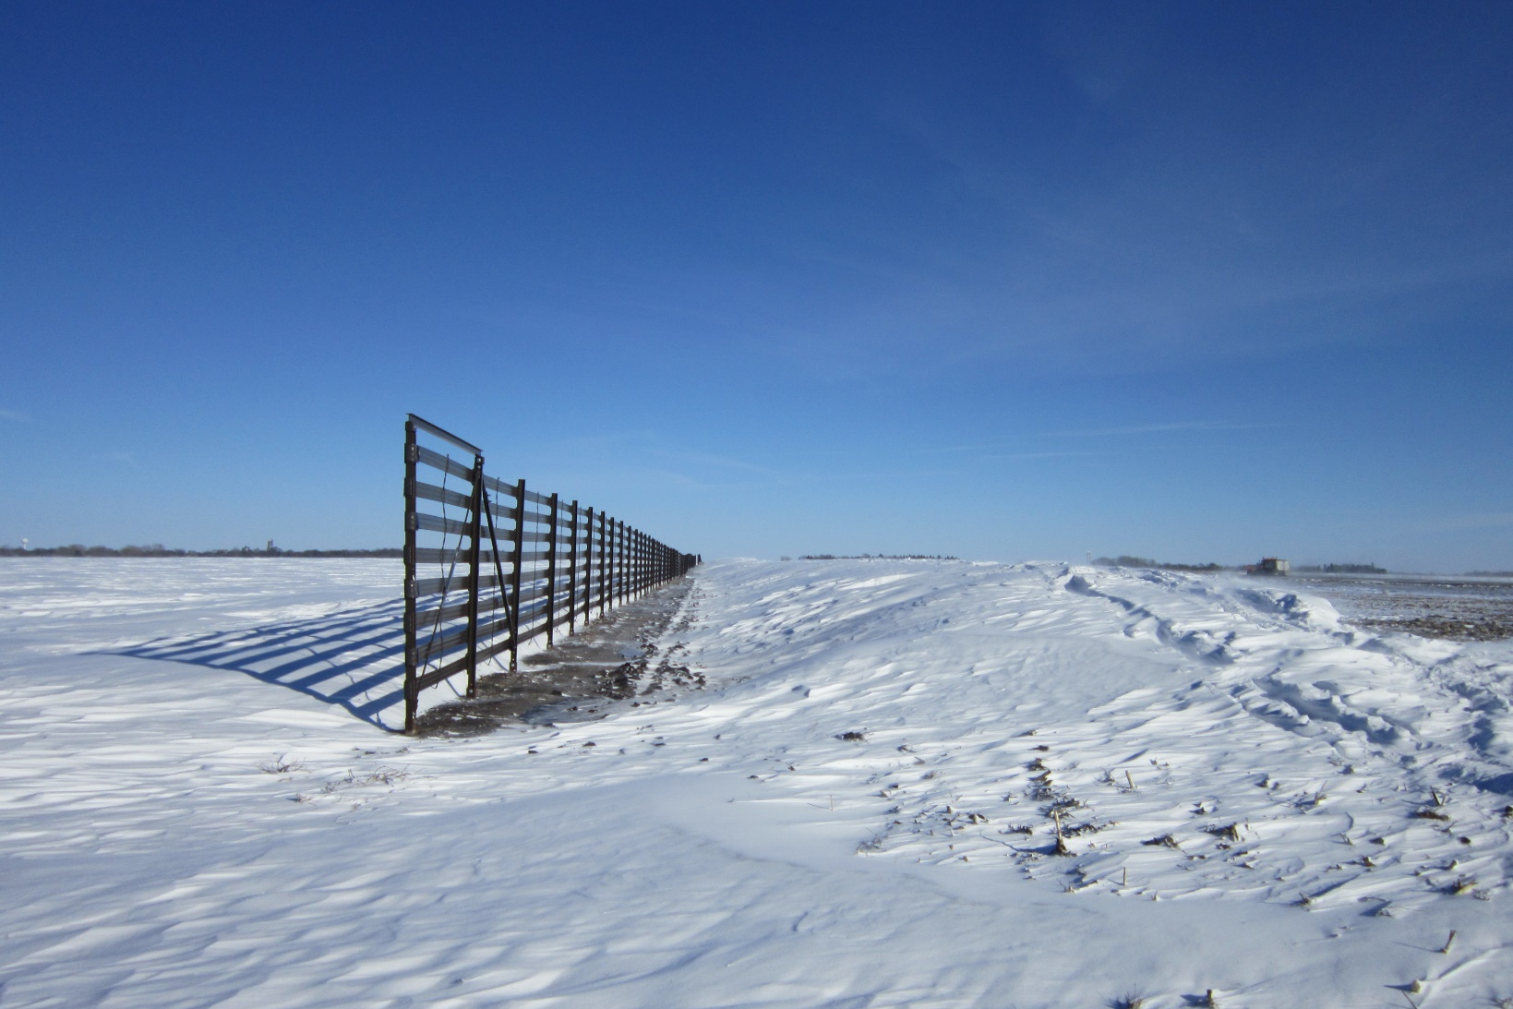
What was our goal?
Transform single-function installations like snow fences and noise barriers
Investigate feasibility of installing photovoltaic (PV) panels
Determine if proof of concept was socially, economically and functionally reasonable
Harvest clean, cost-effective energy
Notes:
The project’s goal was to investigate the feasibility of installing photovoltaic (PV) panels on noise barriers and snow fences as add-on pieces or in integrated designs. The project’s overall objective was to provide a comprehensive proof of concept to determine if the idea was sound—socially, economically and functionally—and a reasonable route for MnDOT and local agencies to take.

Slide 12
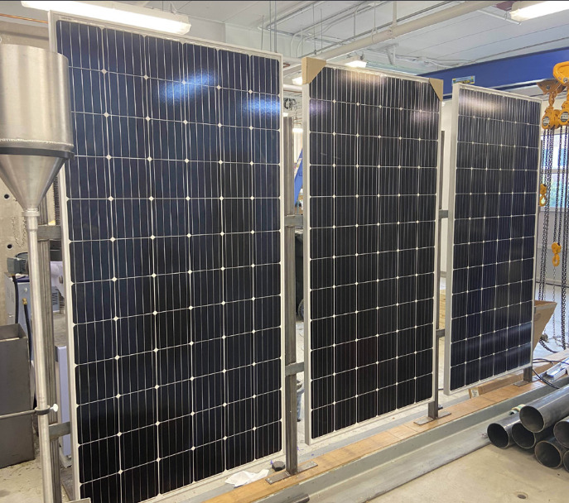
What did we do?
Stakeholder opinion survey and interviews
Constructed a prototype solar noise barrier and snow fence system
Conducted laboratory testing and computer modeling to evaluate traffic and safety impacts
Created a cost-benefit model to calculate the breakeven points for the system
Notes:
To learn stakeholders’ opinion of using PV panels with noise barriers and snow fences, researchers distributed online surveys to members of more than 50 households familiar with noise barrier walls and representatives from 21 utility companies. They also interviewed 20 landowners with farmland where snow fences could be installed.
The research team then constructed a prototype solar noise barrier and snow fence system.
Because the system would be near traffic and could influence safety, researchers conducted laboratory testing and computer modeling to investigate the possible effects of these systems and regulatory aspects of implementation, including:
• Effect of solar panels on noise barrier performance
• Potential for glare from the solar panels, which could hinder motorists
• Change in the effectiveness of PV snow fence in reducing blowing and drifting snow
• Impact on traffic safety resulting from vehicle collisions with solar panels
• Potential electrical hazards to motorists involved in a crash with a solar highway system
The team developed a system of electrical connections between panels. To attach the system to the power gird, they designed a controller and inverter system to convert the system’s DC voltage to an AC charge usable by the local utility company. Researchers also created a cost–benefit model to calculate breakeven points for the system under various scenarios.

Slide 13
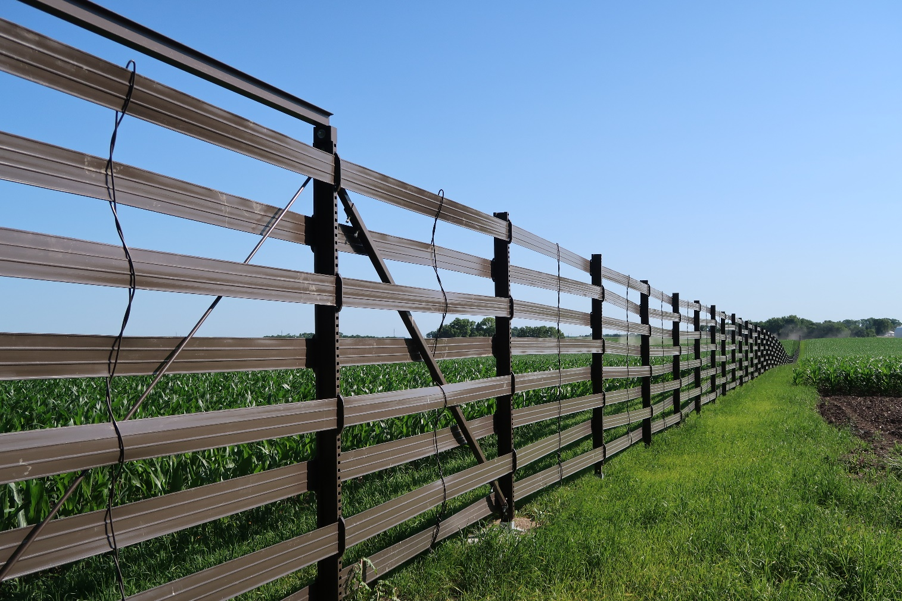
What did we learn?
Literature search: Showed PV panels has been investigated in Europe, but not U.S.
Surveys: Public was overwhelmingly positive about the concept (90%)
Lab testing: Low and high velocity impacts to panels showed fragments from broken panels moved slowly and didn’t post safety hazard
Cost-benefit analysis: In some installations, the system could breakeven in less than a year
Notes:
The literature search revealed that many states have installed PV demonstration projects, and PV panels on noise barriers have been investigated in Europe, but researchers found no projects resembling this effort.
The surveys showed the general public was overwhelmingly positive about the concept (90%); however, that percentage dropped to about half if solar panels reduced noise barrier effectiveness.
Testing showed that the prototype performed its functions seamlessly as it also gathered solar energy to convey to the power grid. Computer modeling of PV panels on noise barriers showed the noise dampening effect of barriers would be reduced only 2%. A simulation of sunlight glaring revealed a minimum of glare (373 minutes per year) for the system. In addition, fluid analysis of snow motion indicated that terrain most affected performance, not the solar panels. In the lab, low- and high-velocity impacts to the PV panels recorded with a high-resolution camera showed that fragments from broken panels moved relatively slowly and did not pose a safety hazard to travelers. Further, the system was not an electrocution hazard.
The team’s cost–benefit analysis indicated that in some installations, the system could reach the breakeven point in less than a year.

Slide 14
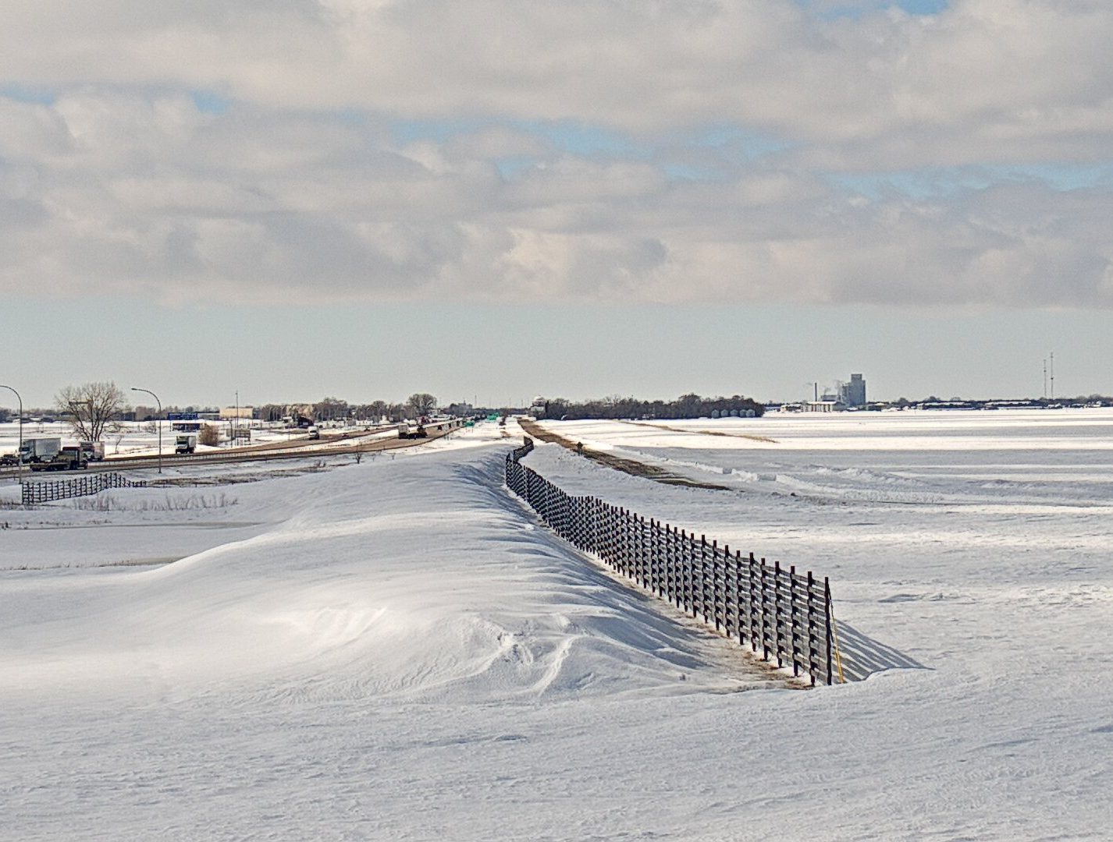

What’s next?
Complete implementation project (June 2025)
Identify possible challenges when implementing on a large scale
Evaluate net benefits over years
Subscribe to receive email alerts about this project!

Slide 15
Thank you!
Jon Solberg
Jon.Solberg@state.mn.us
651-234-7796

